Slide 1
ROBO005 - New Vision System For Robots in Homes
By Marc van Zyl
McIntosh High School, Peachtree City, GA, 30269, USA

Slide 2
Introduction
Purpose: The inability of robots to accurately map 3D environments is one of the biggest hurdles to greater adoption of autonomous robots in our chaotic, unstructured environments. The most common 3D depth mapping systems currently used are stereo vision systems and LiDAR. Stereo systems, which require 2 cameras, are computationally costly and are prone to errors, while LiDAR systems are very expensive, have slow update cycles, and are cumbersome. The purpose of my research is to explore the feasibility of a depth mapping system for robots based on dense optical flow as implemented in most GPU chips by extending the Gunnar Farneback algorithm. Optical flow algorithms measure the speed of movement of objects in sensor space given a stationary camera. I set out to determine whether this technology can be applied to measuring the distance to stationary objects in real-world space if the camera’s velocity in real-world coordinates is known, as is the case in most ground-based robots.
Research question: Can an optical flow depth mapping system using a modified Gunnar Farneback dense optical flow algorithm outperform a traditional stereo depth mapping system using similar optical hardware in the generalized case of planar motion?

Slide 3
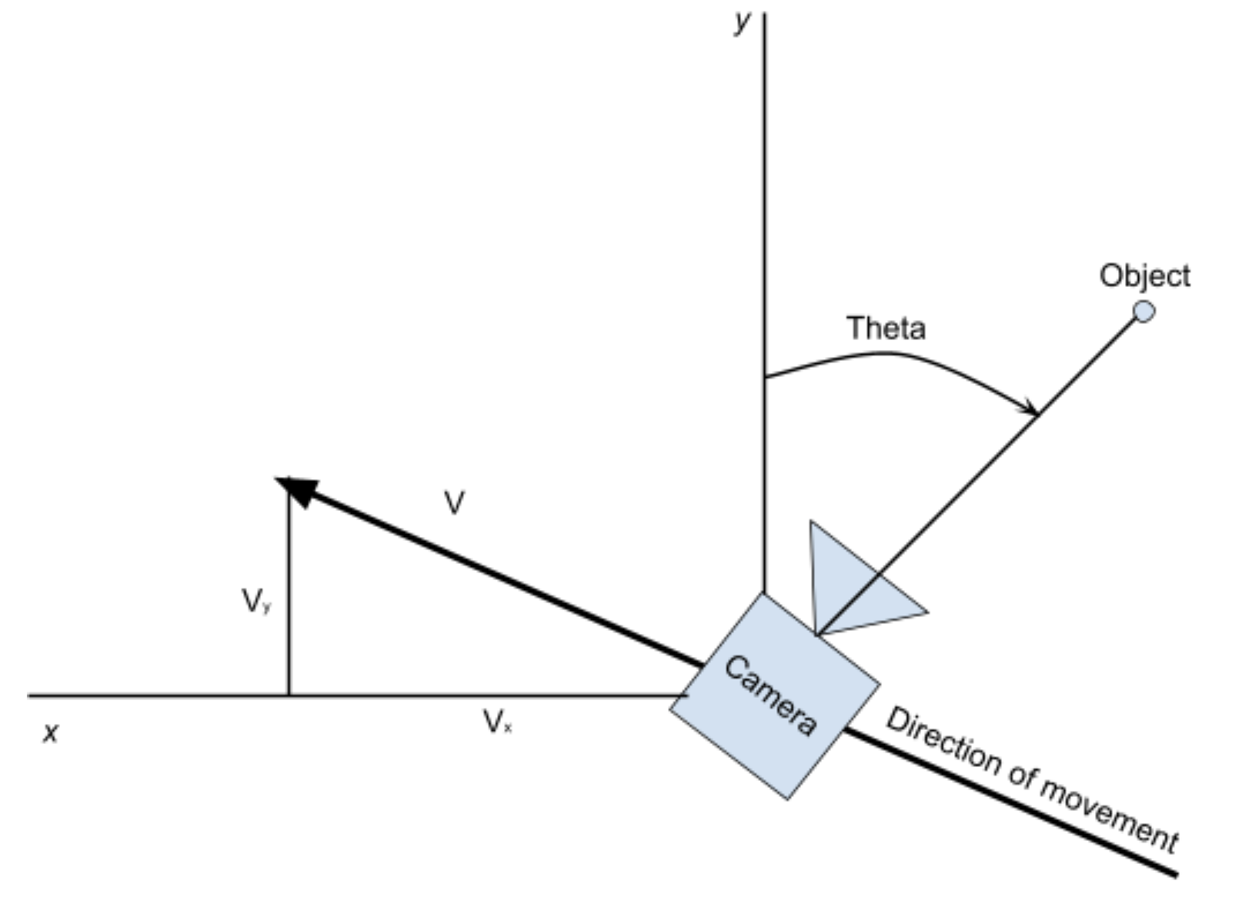
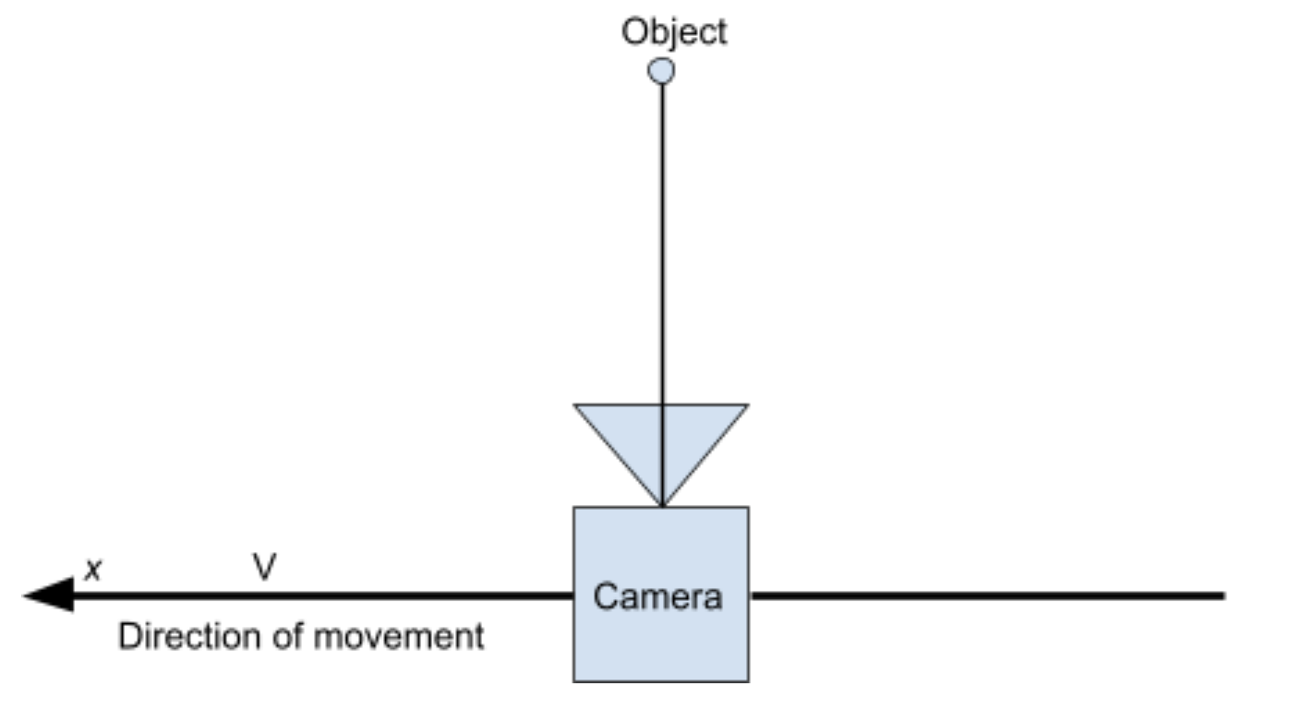
Introduction Cont.
Continuation project: Last year, I tested optical flow, using a camera moving linearly in the x direction with a camera orthogonal to the movement (Figure 1), compared with a stereo vision system. Although the performance of the optical flow system was impressive, it was a special case and one that would not solve the general problem of depth mapping in practical situations. In this research, the goal was to expand the experiment to the real-world, universal case where the camera could move in any direction (x and y) while also rotating with a constant velocity (Figure 2). What seemed like a moderately complex extension to the original research became very complex when the experimental data revealed discrepancies. In the end, I had to develop my own algorithm to account for the complex mapping between points in the real-world space and pixels on the flat camera sensor. Refer to the research paper for more background to this solution.
Figure 1. Layout of 2020 Science Fair Experiment
Figure 2. Layout of 2021 Science Fair Experiment

Slide 4
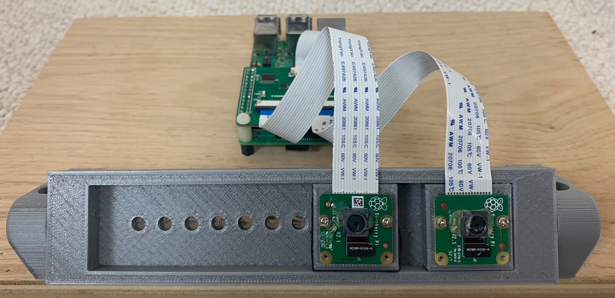
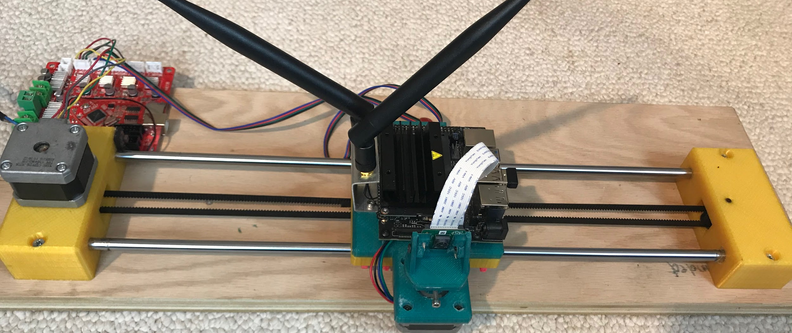
Methodology
Controls - Camera lighting; image pre-processing procedure; identical cameras and lenses in experimental and control groups; identical camera calibration procedures.
Control group - Build a stereo vision system with two calibrated cameras. Perform stereo rectification on the cameras to find the transformations to digitally align the sensors (Figure 3).
Experimental group - Optical Flow vision system consisting of a single calibrated camera on rotational mount fixed on a precision linear slide. The linear and angular velocities can be accurately controlled using stepper motors driven by a 3D printer controller (Figure 4).
Figure 3. Stereo camera setup
Figure 4. Optical Flow camera setup

Slide 5
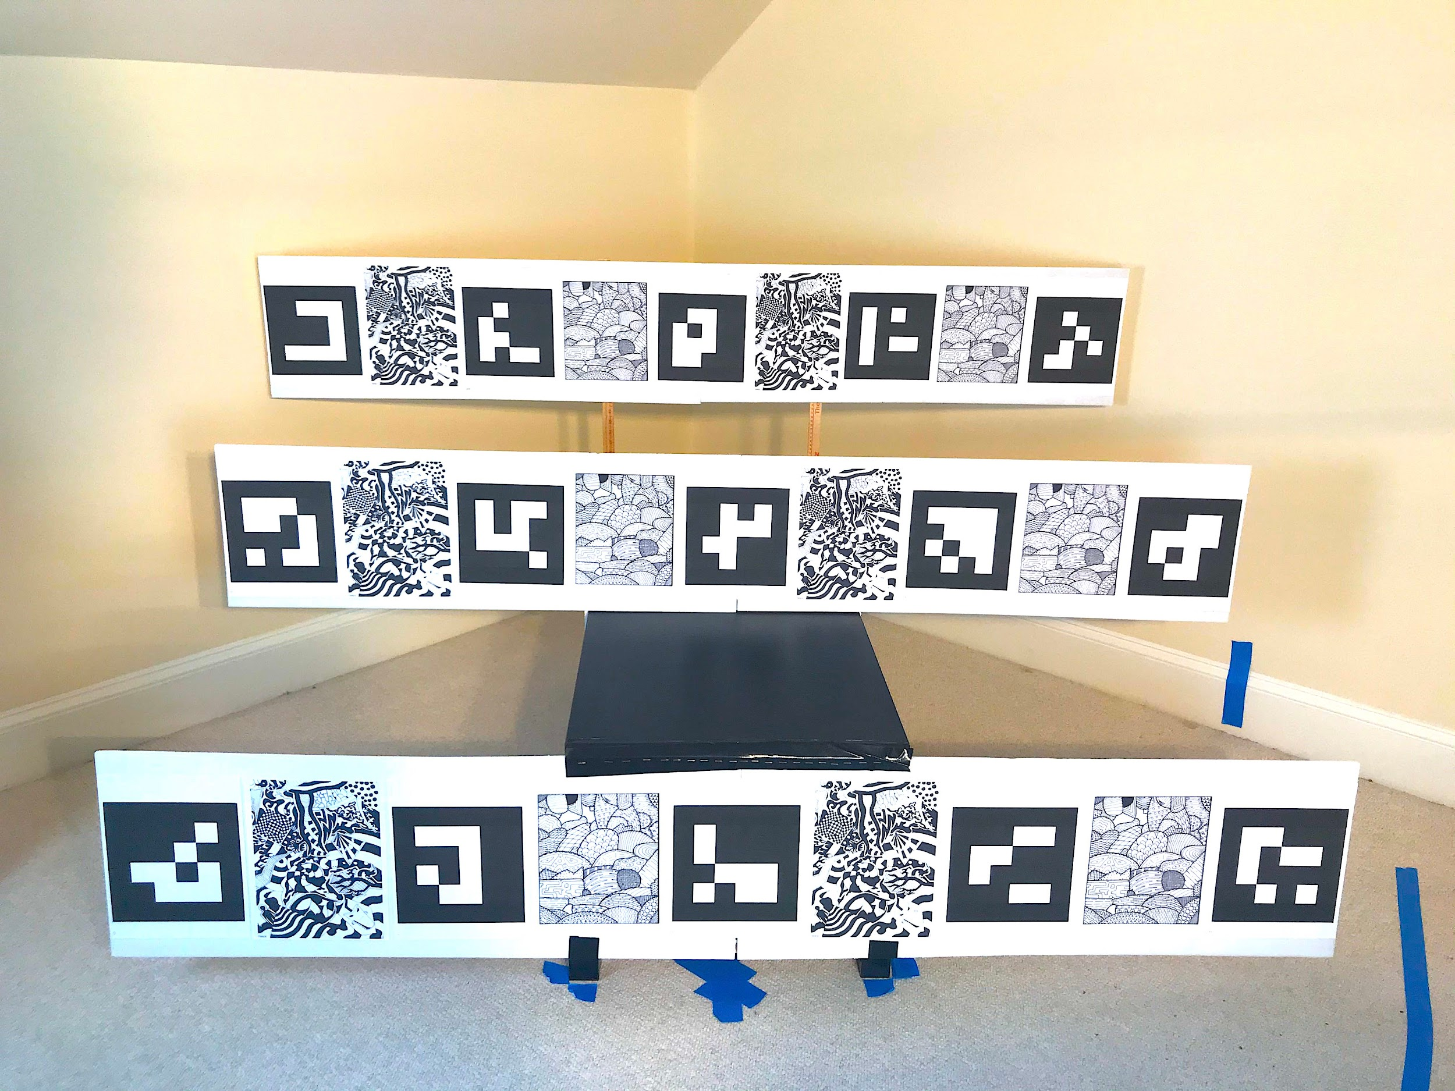
Methodology Cont.
Scene - Create a common experimental scene using Aruco markers alternating with optically interesting and non-repeating Optical Flow Zones (OFZs) at known distances from the camera. The scene is controlled for lighting and all other factors (Figure 5).
Experimental procedure - After calibrating the cameras, collect 10 sets of video data for linear movement speeds of 15, 30, 45, 60 mm/s, and for rotational speeds of 0, 4, 6 degrees/s. Measure the distance to each Optical Flow Zone(OFZ), which are shown in green in Figure 5, and find mean and standard deviation of the data.
Control procedure - Stereo vision: Record 50 sets of stereo pictures of the scene, process and transform these to extract the depth information for the center of each OFZ (n=50).
Analytics - Process the stereo camera and optical flow camera data using the analytical process described in the research report. Analyze the data using standard statistical procedures.
Figure 5. Experimental scene using aruco markers for reference points to find the location of OFZs (green)

Slide 6
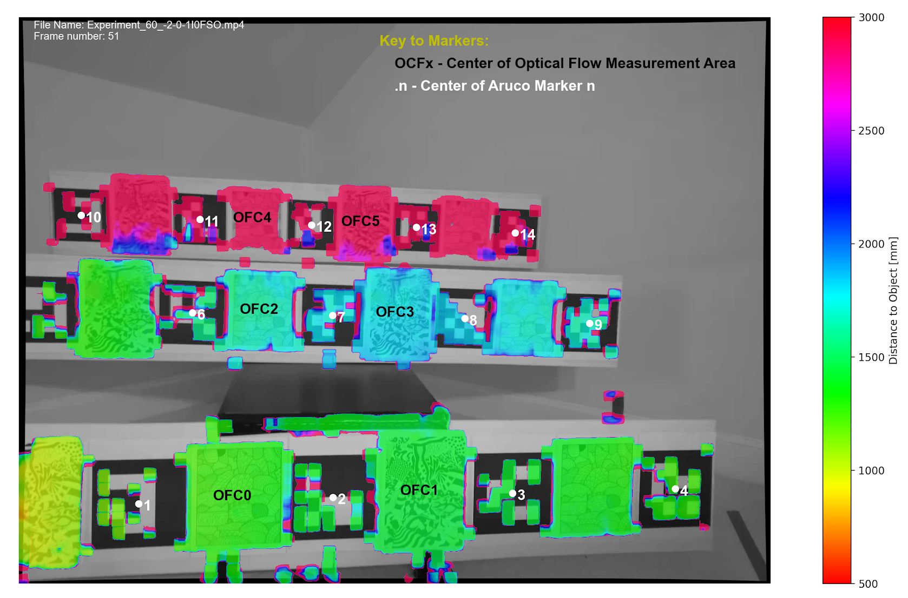
Results
After processing the data files and extracting the distance for each OFZ, the results were analyzed statistically.
Figure 6 shows a depth map from one sample frame, and converts all distances found to colors for easy viewing. (Refer to the research paper for more details). The final results were calculated using an average of a 1 second rolling window of data (21 frames) to smooth inevitable noise in the data.
Figure 6. Sample frame from optical flow system converting estimated distances into colors (v=60mm/s,θ’=-4deg/sec, frame:51)

Slide 7
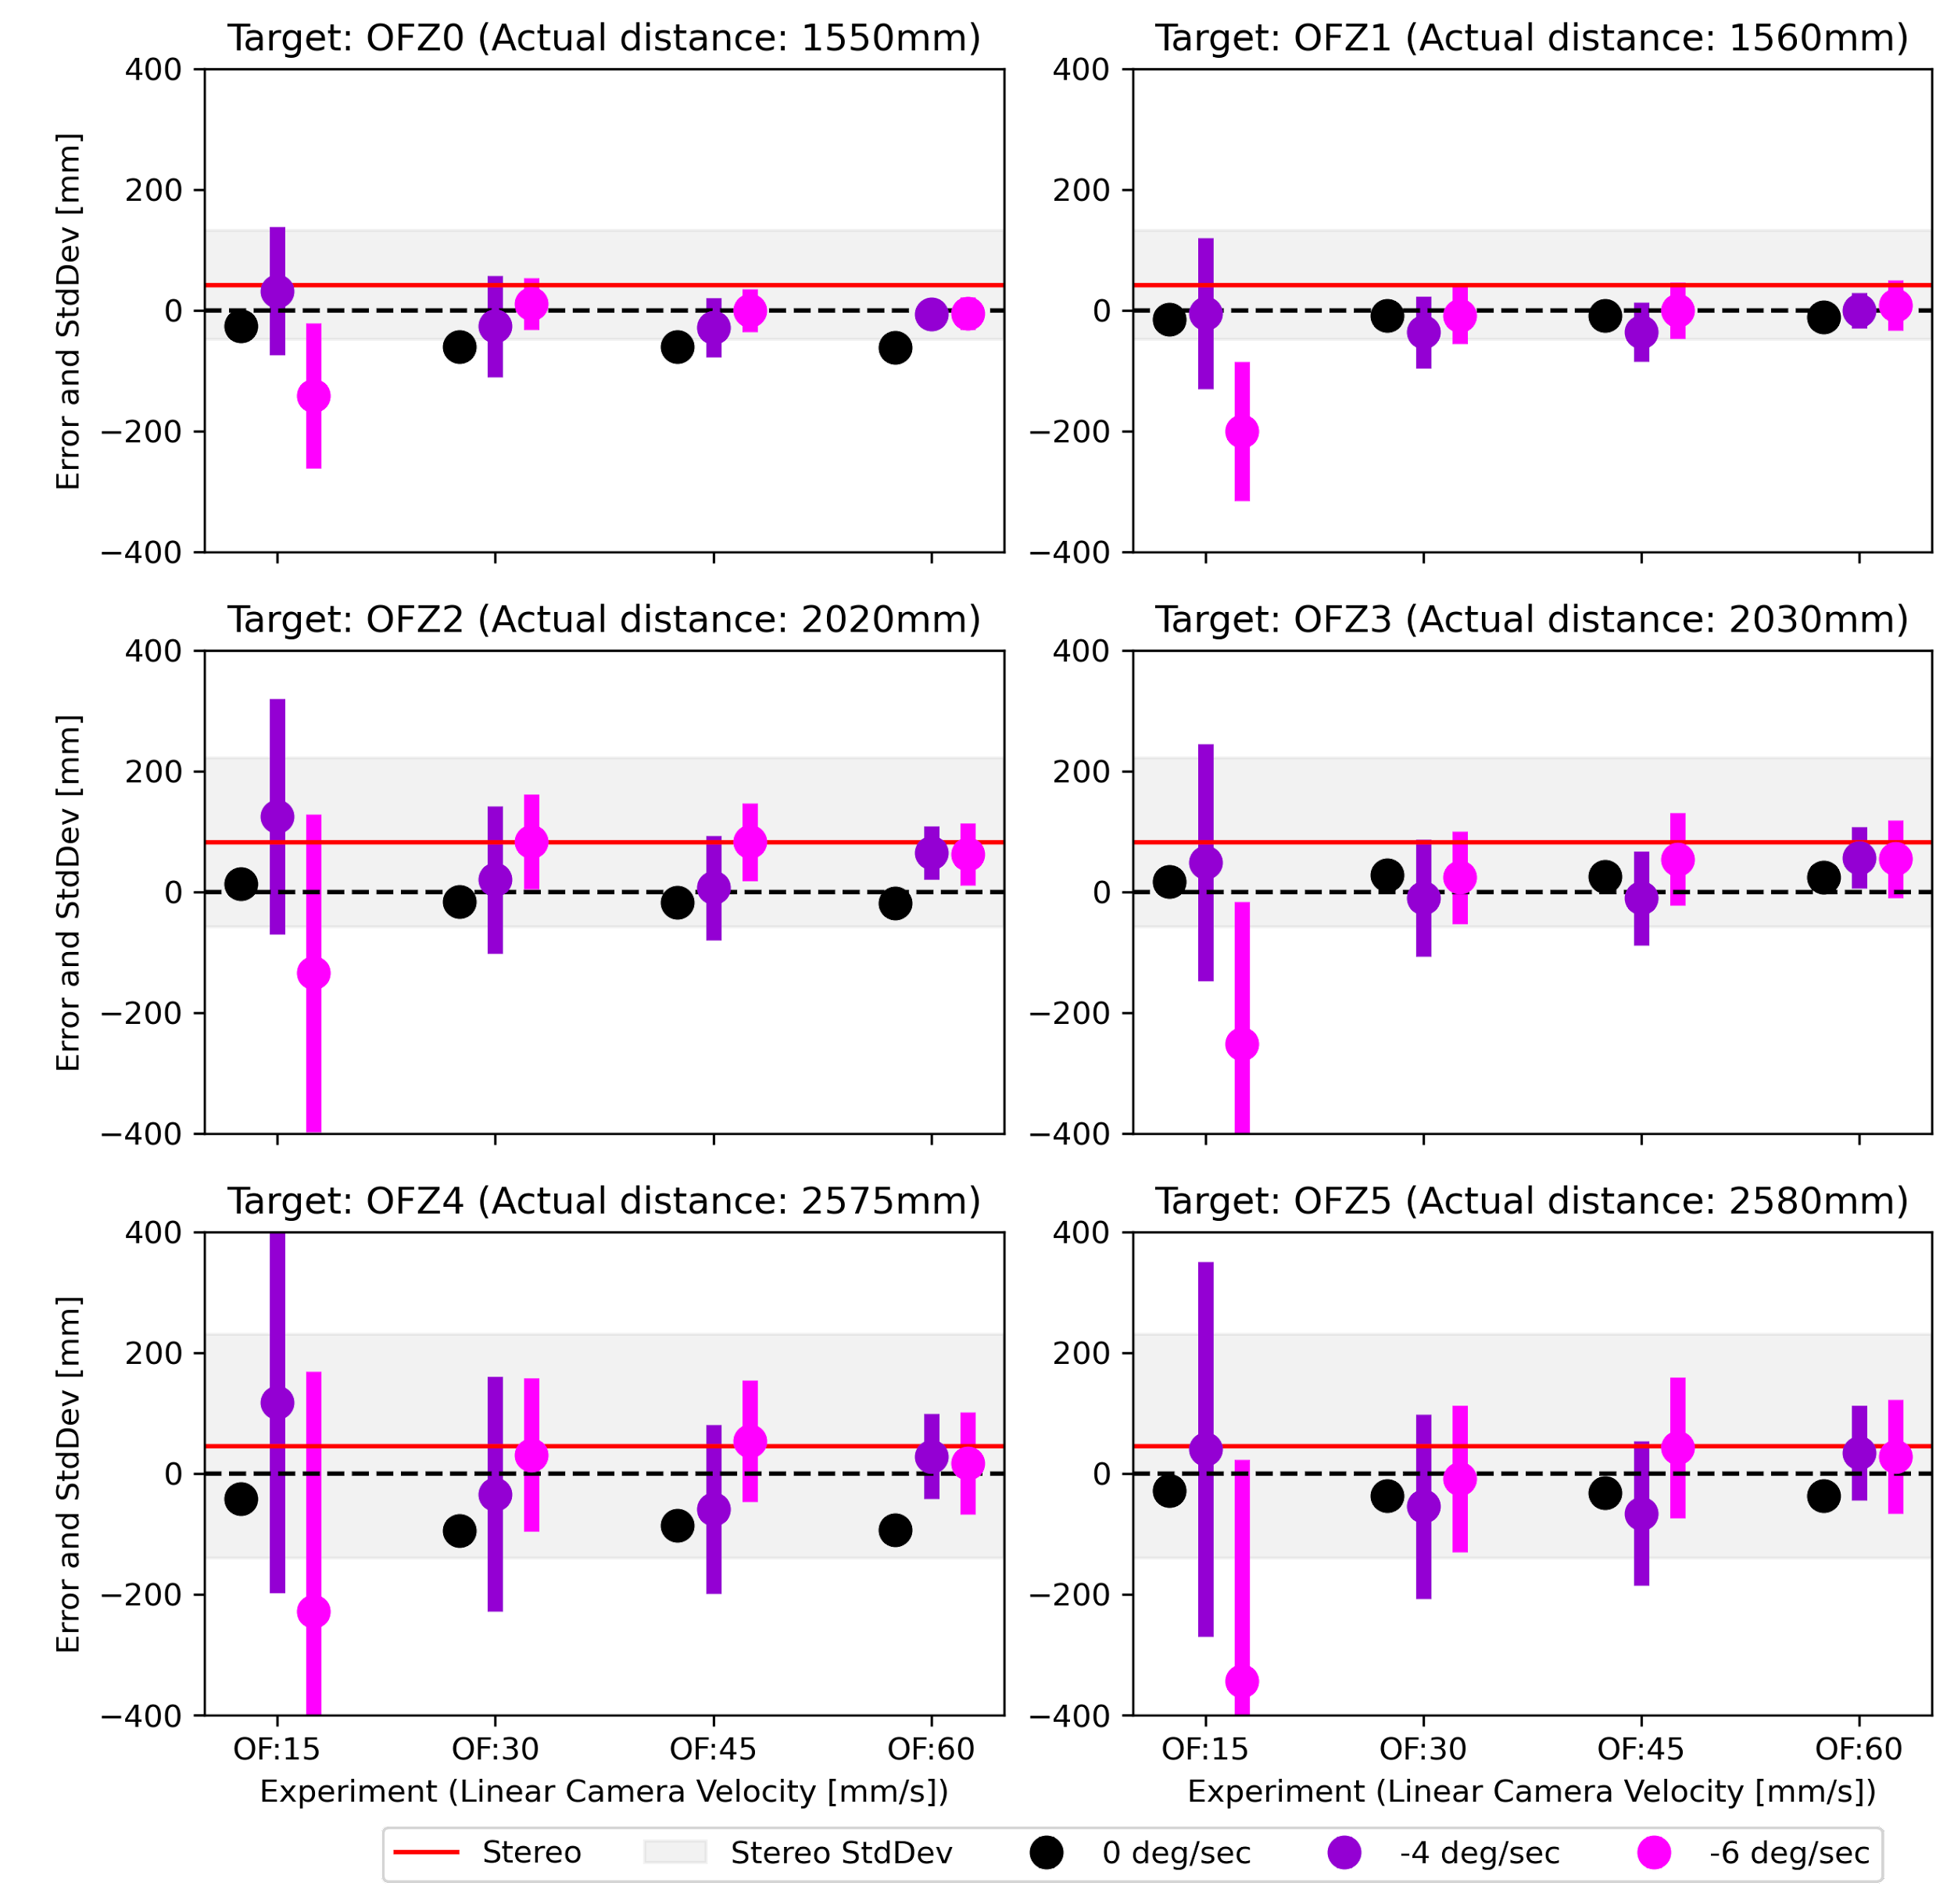
Results Cont.
Figure 7 shows the final results for the Rolling Window Errors (dots) and the standard deviation of these errors (bars) for all the experimental cases. The stereo camera results are indicated by the red line (mean error) and the gray shading (standard deviation of the error). The color of the dot and bars refer to the rotational velocity while the linear velocity of the cameras are annotated on the x axis. Where a dot appears closer to the dotted line than the red lines does, the optical flow system performed better than the stereo vision system.
Rotational speeds of Optical Flow camera
Figure 7. Final summary results

Slide 8
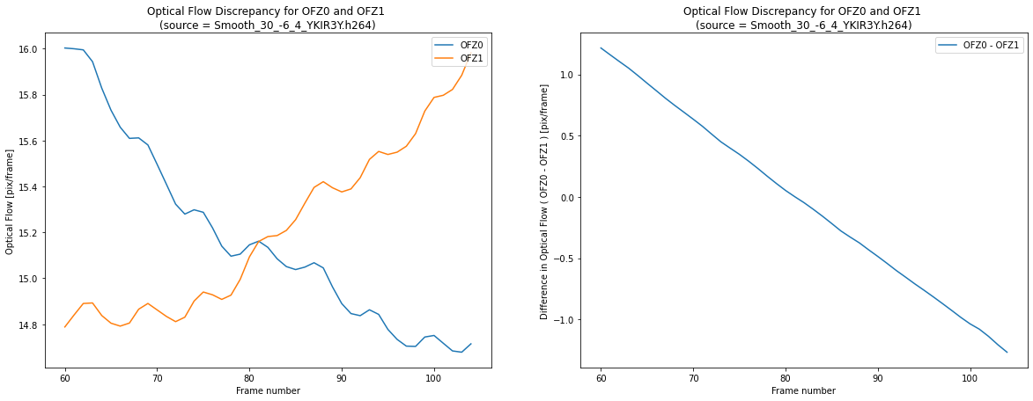
Discussion
During the data analysis it was found that the accuracy of depth map was highly dependent on the position of the object in the frame. When the object was close to the center of the image frame the depth calculation was accurate, but as soon as the object moved towards either side of the frames the accuracy declined dramatically. After checking every step of the experimental setup and confirming that there were no problems, the problem was found to be in the optical flow to depth conversion algorithm.
Unlike the human eye, where the sensor (retina) is curved, the digital cameras have flat sensors. This means that the velocity of pixel movements are non-linearly related to velocities in the real-world space depending on the position of the projection on the sensor (Figure 8). This required a redevelopment of the algorithm to map movement in sensor space to movement in real-world space to account for this.
Figure 8. Discrepancy in flat sensor

Slide 9
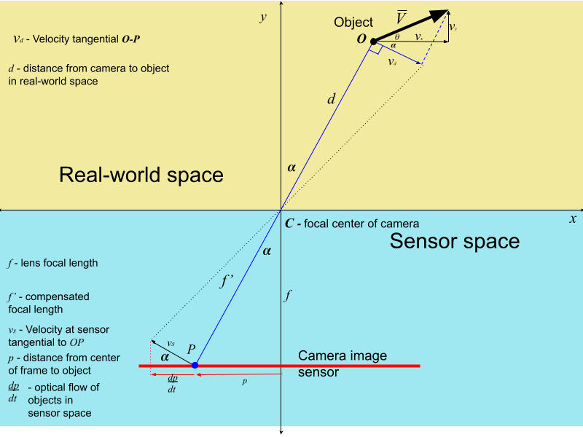
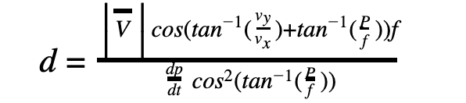
Discussion Cont.
Figure 9 graphically shows the relationship between movement of a point in real-world space and movement of the pixel in sensor space. The transformation algorithm between movement perceived in sensor space and the distance to object (given the linear movement of the camera) is also shown, where d is the distance to the point, v is the camera velocity, p is the distance of the point on the sensor from the center (p = 0 is the center of the frame), and f is the camera lens focal length. The research paper shows the process to make this equation, and provides a larger view of the figure.
Figure 9.
The final results presented were calculated after applying this transformation. From these results is evident that with linear camera velocities of 30 mm/s and higher, the Optical Flow system is more accurate and precise than the stereo system. However, as expected, the optical flow system losses accuracy and precision as the linear velocity of the camera declines. This would seem to indicate that while optical flow is great for applications where the robot moves - like mapping rooms while roaming, it does not perform well when the robot slows down - like when it may have stopped to manipulate objects. Finally, a feature was added that used optical flow calculated in the preceding frame as an initial guess to improve the accuracy in the following frame. Combining this feature with the one second rolling window averaging approach improved optical flow results considerably.

Slide 10
Conclusion
The research showed that the accuracy of an optical depth mapping system was equal to or greater than that of a stereo vision system in most scenarios, answering my question about the comparative effectiveness of these two systems. The exception is for very slow linear motion speed of 15 mm/s or less. Equally importantly, it provided useful information on the limits of the optical flow system that are crucial for the design of a practical depth mapping system. The optical flow system requires a linear velocity orthogonal to the camera direction of at least 30 mm/s. While the experiment did not explicitly test the upper bound of the acceptable rotation speed, the results show that rotational speeds of 6 degree/s or less are acceptable.
Analysis of the statistical distribution of the errors is also insightful. As the distance to the targets increase, so does the standard deviations of the errors for both systems. While this is not surprising, it does point to the potential to implement an adaptive windowing strategy that averages data over a longer period of time for points that are further away, while implementing a shorter window for points closer by.

Slide 11
Conclusion Cont.
These results are meaningful for the future autonomous robots in unstructured space. They can provide a cheaper and more accurate alternative to other solutions, like a stereo system. Furthermore, the system was based on the popular Gunnar Farneback optical flow algorithm, versions of which have already been implemented in the hardware of most GPU chips in computers, phones, and MCUs to support H.264 video compression. This means that it would be feasible simple to implement a real-time depth mapping sensor running at speeds of at least 10 frames per second with current technology. This is an advantage over other algorithms that take up to 20 seconds to analyze a frame.
Based on the results of this research, it is possible to design a sensor that could be mounted on a moving element and which would create 3D maps without the robot moving. The system would mimic our depth perception where we can perceive depth by simply rotating our gaze. Assuming linear velocity of 30 mm/s and rotational speed of 6 degrees/s, a camera with an offset of 268 mm from the point of rotation can instantly map a room with great accuracy, revolutionizing current mapping processes and paving the way for less computationally expensive, more accurate autonomous robots.

Slide 12
References
Farnebäck G. Two-Frame Motion Estimation Based on Polynomial Expansion. In: Bigun J, Gustavsson T, editors. Image Analysis. Springer Berlin Heidelberg; 2003. pp. 363–370. doi:10.1007/3-540-45103-X_50
Camera calibration. (2017). Retrieved April 18, 2021, from https://docs.opencv.org/master/dc/dbb/tutorial_py_calibration.html
Andijakl, P. (2020, December 16). Understand and apply stereo rectification for depth maps (part 2). Retrieved April 18, 2021, from https://www.andreasjakl.com/understand-and-apply-stereo-rectification-for-depth-maps-part-2/
Heeger, D. J. (1987). Model for the extraction of image flow. Journal of the Optical Society of America A, 4(8), 1455. doi:10.1364/josaa.4.001455
Grimson, W. E. L. (1985). Computational Experiments with a Feature Based Stereo Algorithm. IEEE Transactions on Pattern Analysis and Machine Intelligence, PAMI-7(1), 17–34. doi:10.1109/tpami.1985.4767615
Henry, P., Krainin, M., Herbst, E., Ren, X., & Fox, D. (2014). RGB-D Mapping: Using Depth Cameras for Dense 3D Modeling of Indoor Environments. Springer Tracts in Advanced Robotics, 477–491. doi:10.1007/978-3-642-28572-1_33
All photos, graphs and charts on this presentation not cited are taken or created by Marc van Zyl

